Slide 1

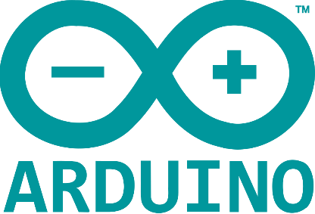
Graphical User Interface (GUI) for Robotics
Written by :
Muhammad Husni Muttaqin, S. Pd
© Ardumeka (2022)
SUMEDANG CREATIVE FEST

Slide 2
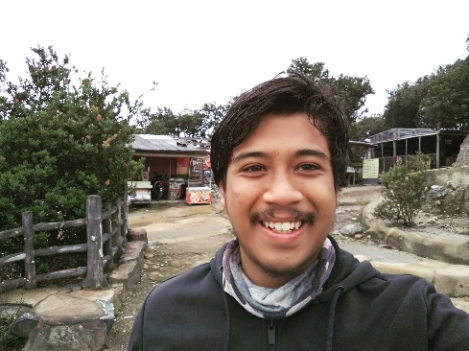
About me
Name : Muhammad Husni Muttaqin, S. Pd.
Birth date : 5 June 1998
Hometown : Bandung
Current Job : python programmer at PT Syergie Indoprima and part time teacher
Experiences :
- 2019 - 2020 : Dynamics Positioning System engineer on cable ship (PT Syergie Indoprima)
- 2021 - 2022 : Electronics and control system engineer for Vent-I (PT Syergie Automa Teknologi)
2022 – now : Python Programmer PT Syergie Indoprima
2021 : Founder Komunitas Belajar Ardumeka (Arduino dan Mekatronika)

Slide 3
Bahasan
Interface
Command Line Interface vs Graphical User Interface
Studi Kasus
Bagaimana cara belajar membuat Graphical User Interface yang terhubung dengan Robot
Demo Interface Sederhana dengan Robot

Slide 4
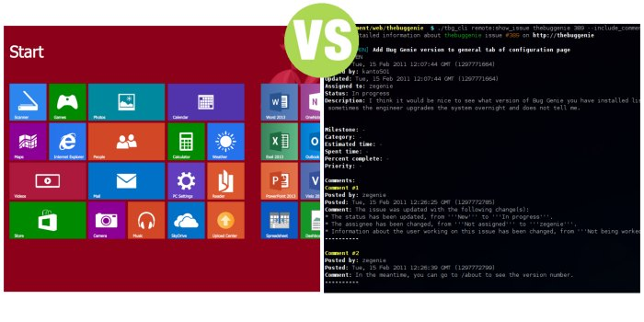
GUI vs CLI

Slide 5
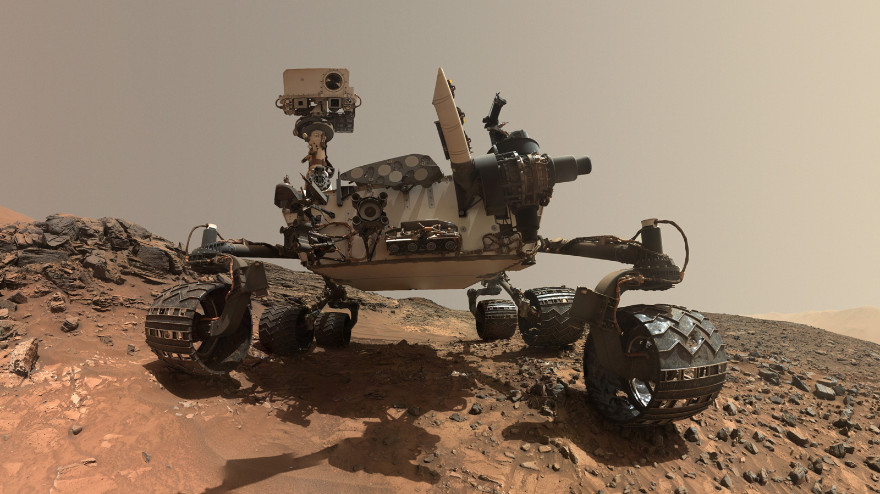

Slide 6
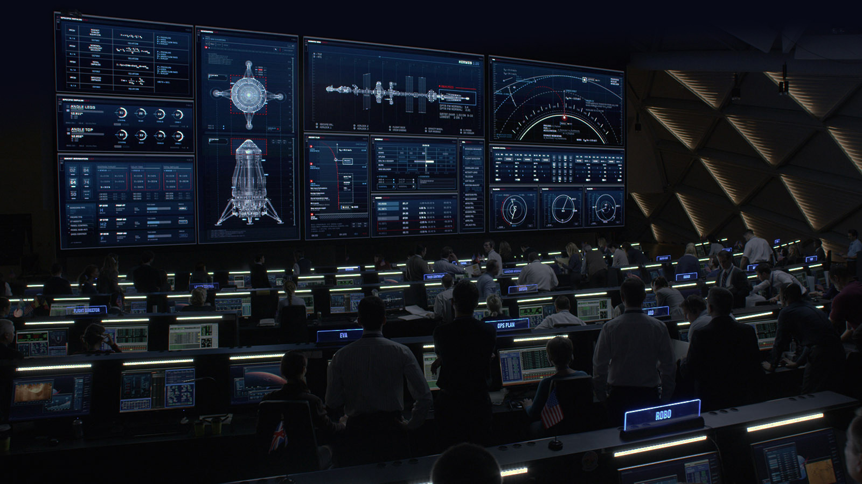

Slide 7
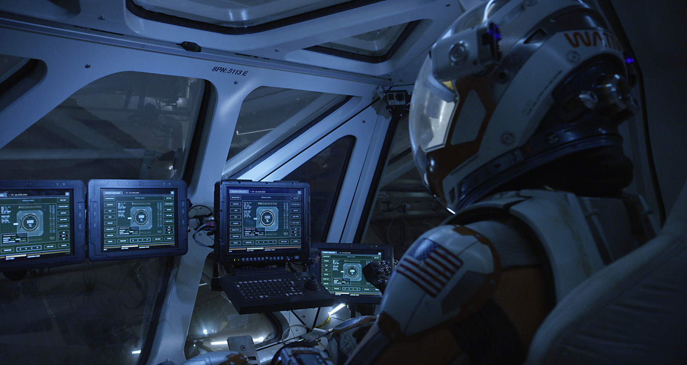

Slide 8
Kang husni pernah bikin GUI ga ????

Slide 9
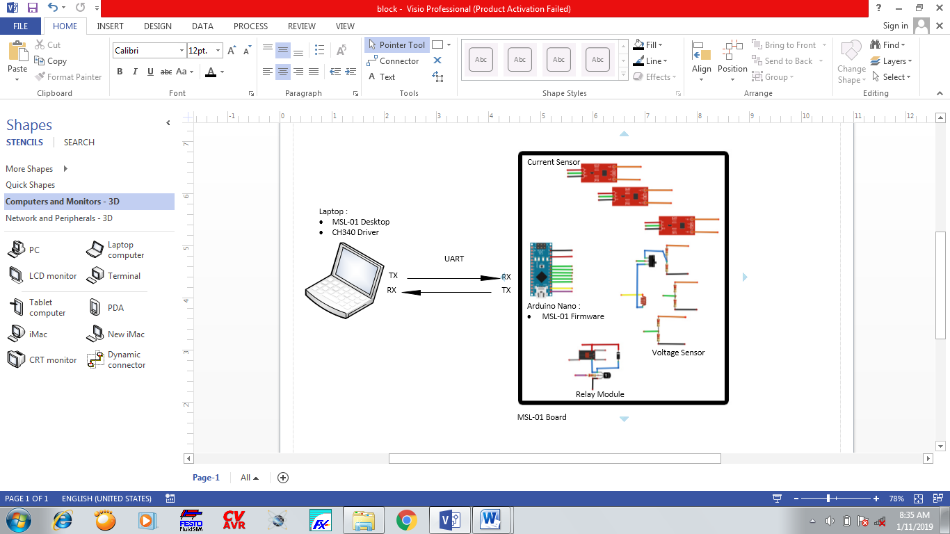
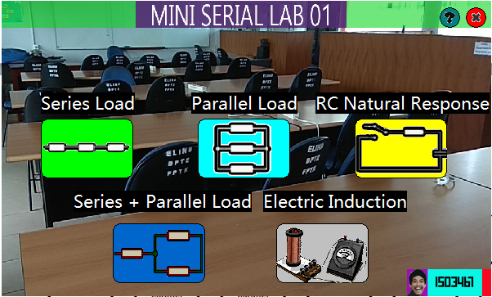
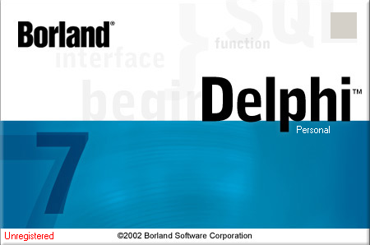
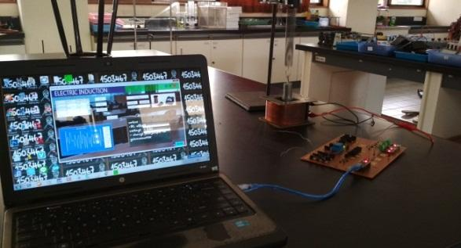
GUI pertama saya. Pas tugas akhir

Slide 10
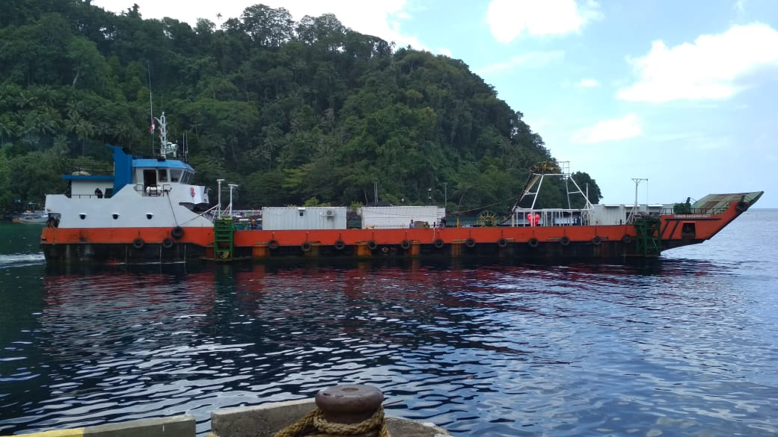
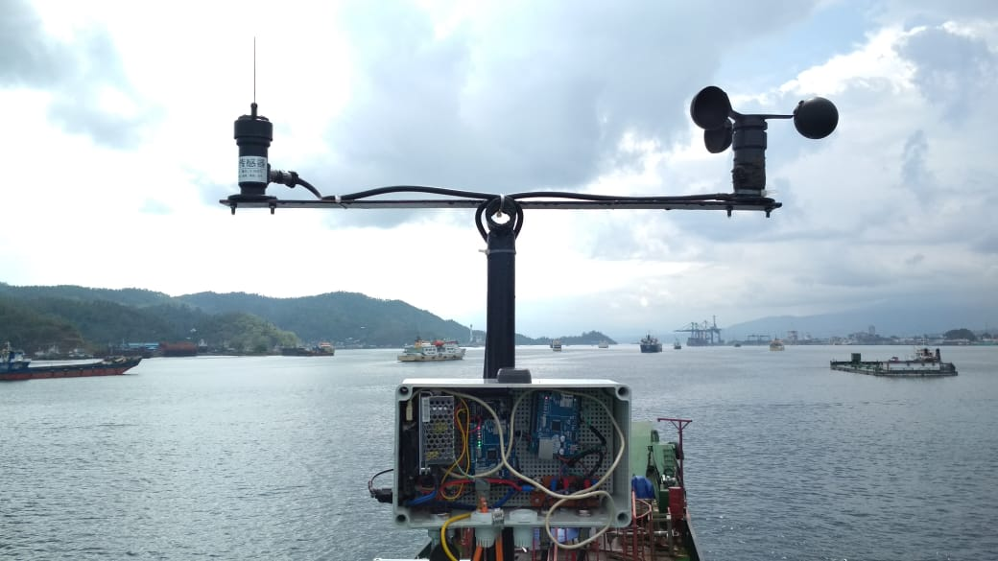
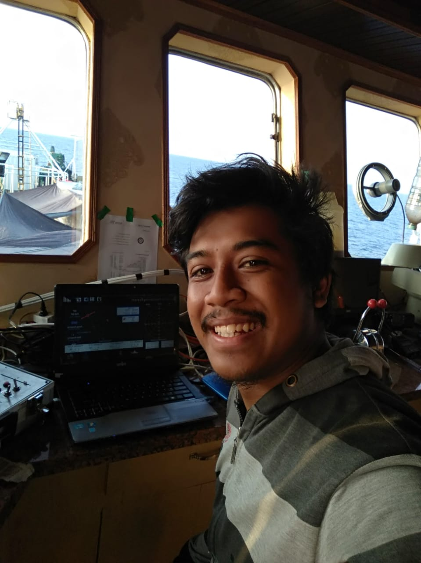
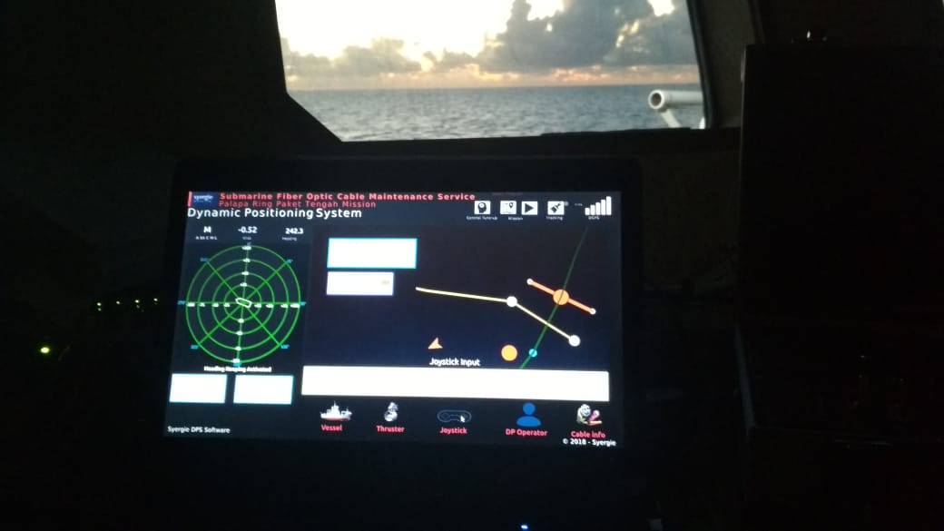
Kapal Maintenance Palapa Ring Tengah ondongsiau – manado km 6- km 12

Slide 11
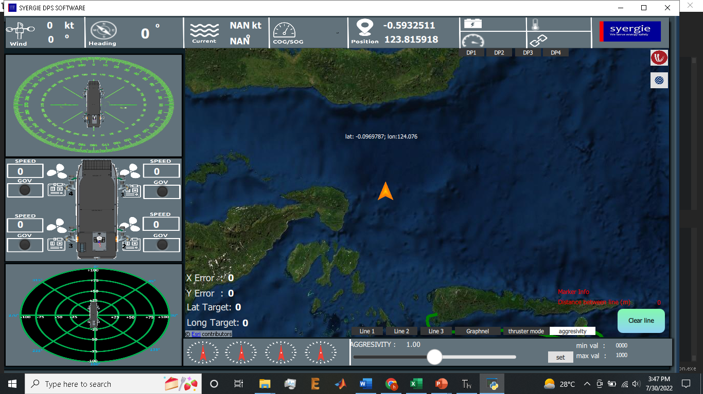
Terus selain itu bikin apa aja ?

Slide 12
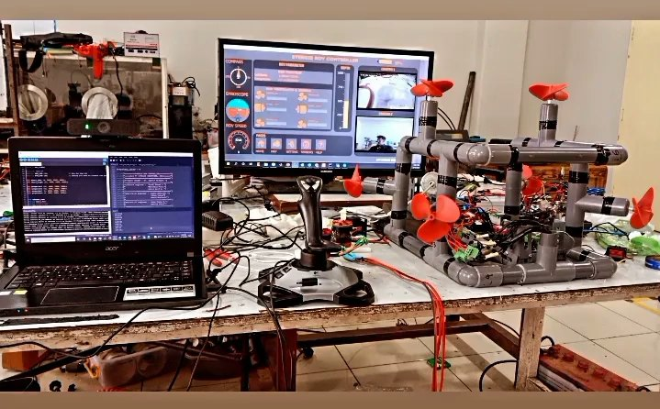
Research and Development ROV

Slide 13
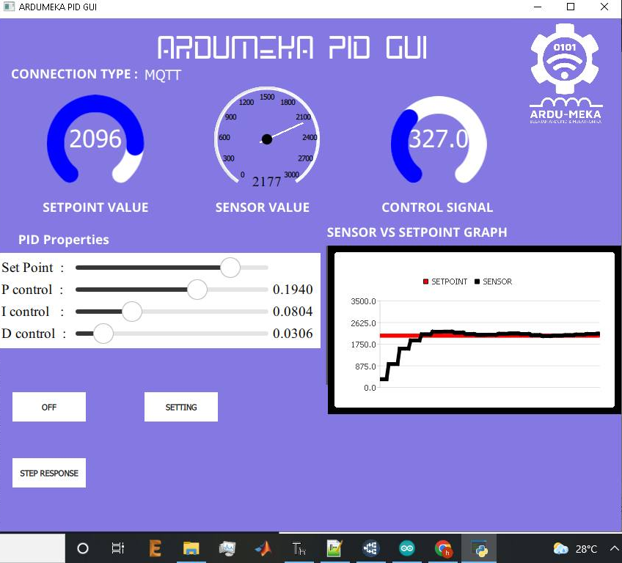
Alat Peraga Sistem Kendali PID

Slide 14
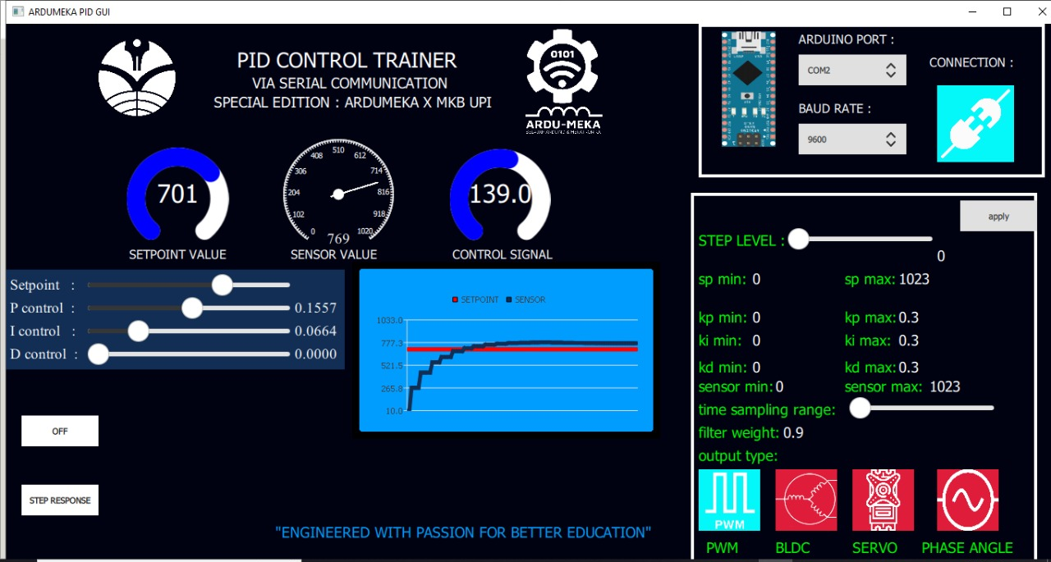
Kerjasama Komunitas Ardumeka dan UPI Purwakarta

Slide 15
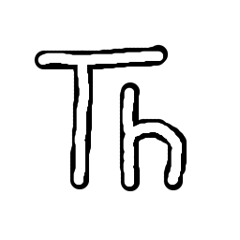
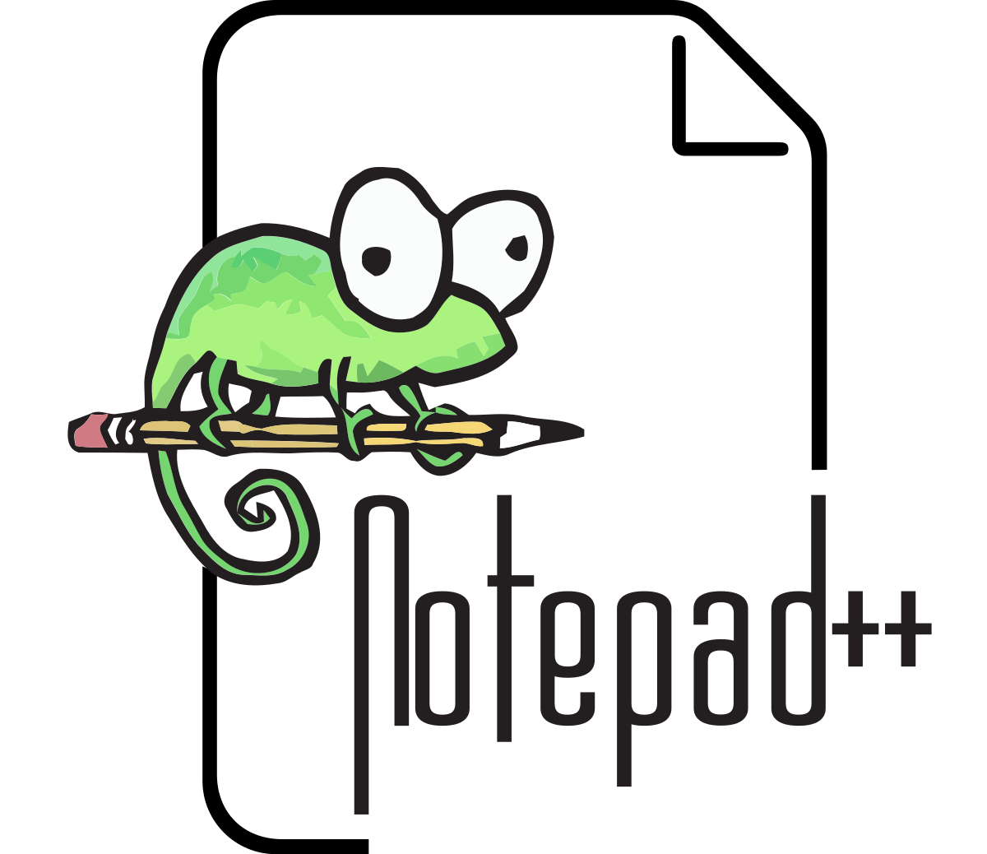
Itu bikin itu pake software apa ya ?
Thonny IDE (Bahasa Pemrograman Python)
Notepad ++ (Bahasa Pemrograman QML)
16.8 Mb
3.7 Mb

Slide 16
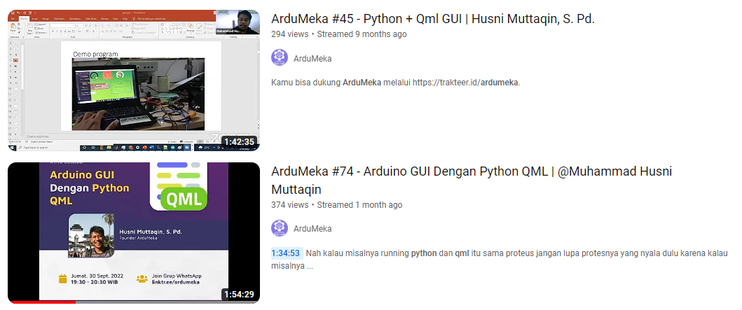
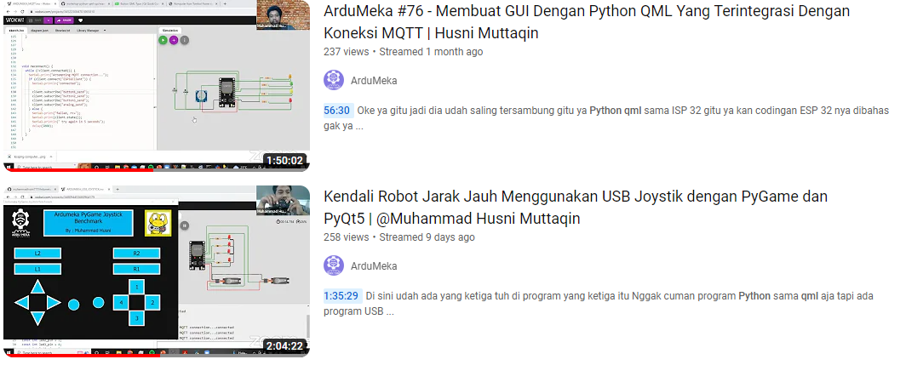
Belajar Bikin GUI Gimana caranya ?

Slide 17
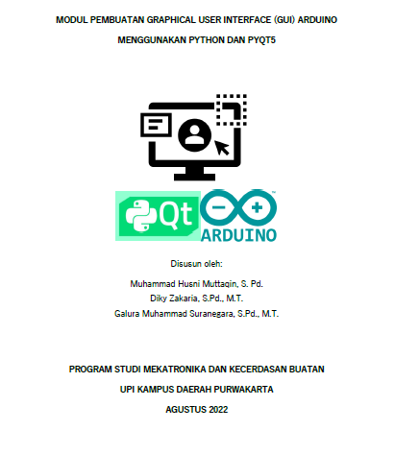
atauuuu
https://github.com/muhammadhusni777/workshop-python-qml-upi/tree/main/PYTHON%20QML%20UPI%20PWK

Slide 18
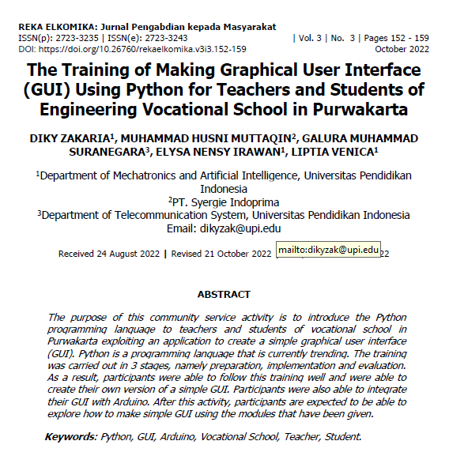
atauuuu

Slide 19
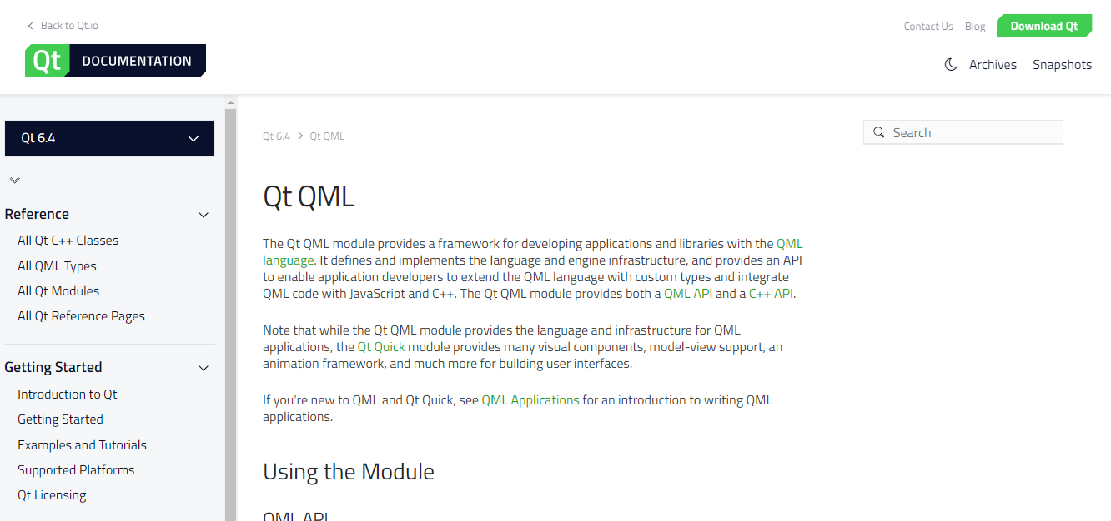
Kalau misalnya masih kurang bisa kunjungi qt.io

Slide 20
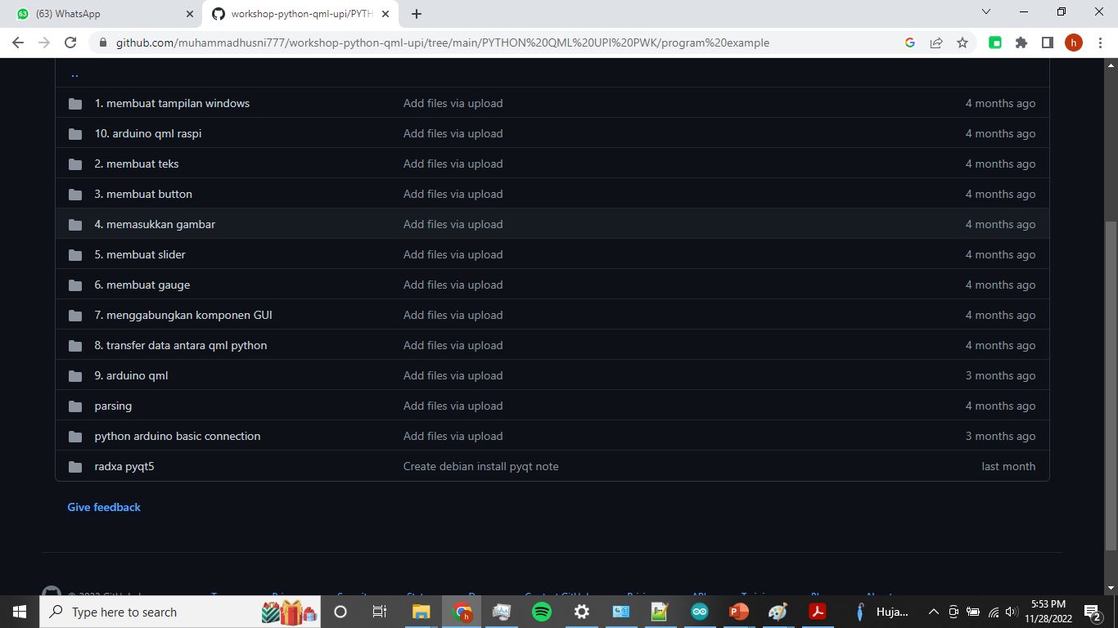

Slide 21
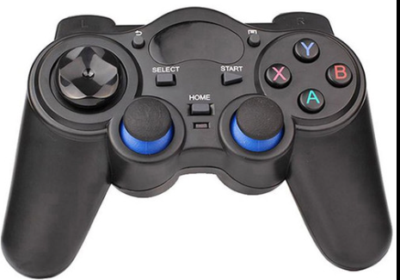
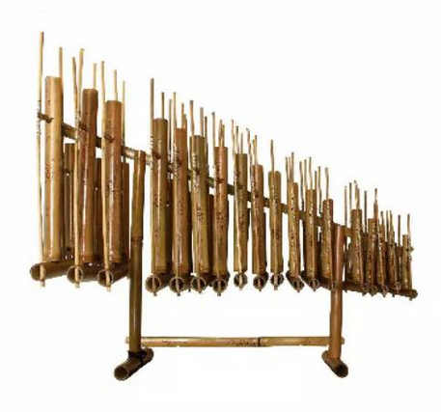
Kita ada sedikit demo nih hehehe
Python
Pygame
Pyqt5
Pyserial
Pyaudio
Microcontroller
Arduino
Angklung

Slide 22
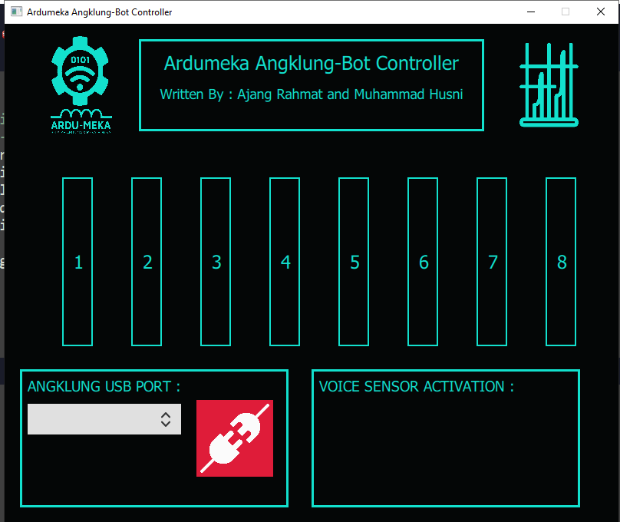

Slide 23
Oke kita coba yaaa………

Slide 24
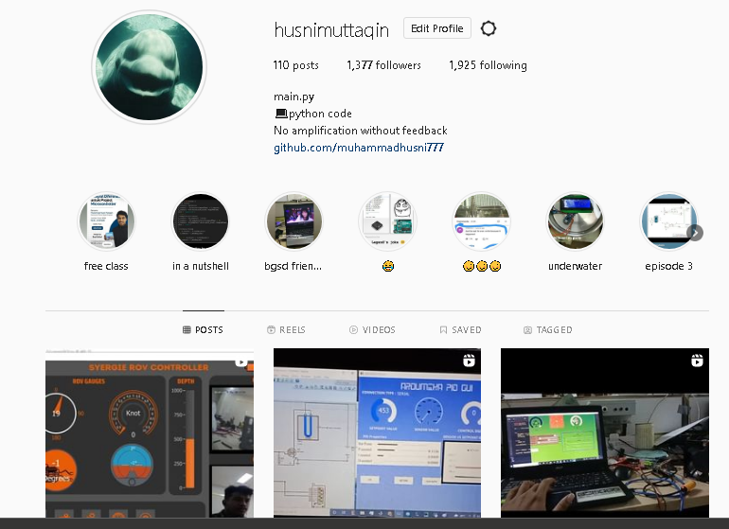
My Instagram

Slide 25
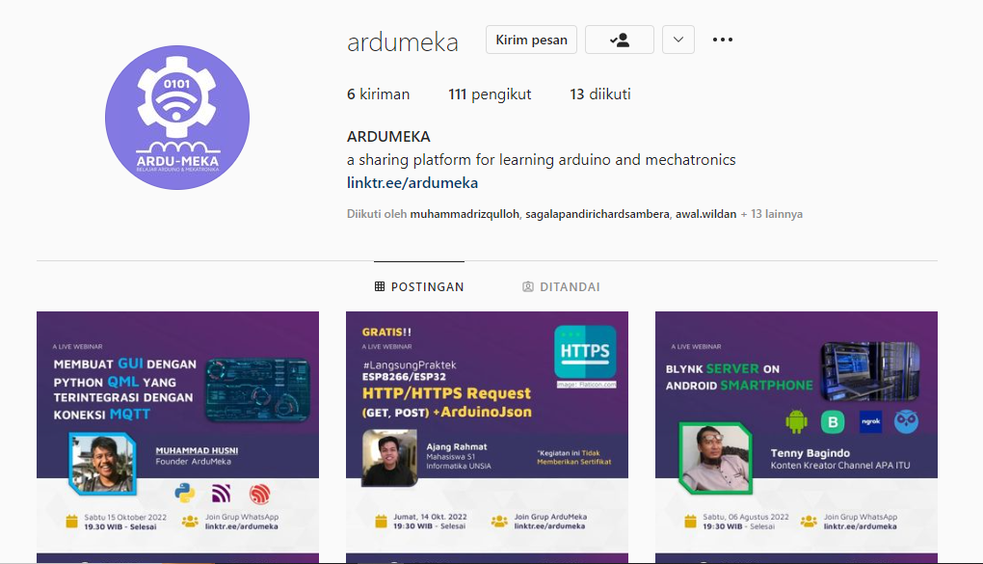

Slide 26
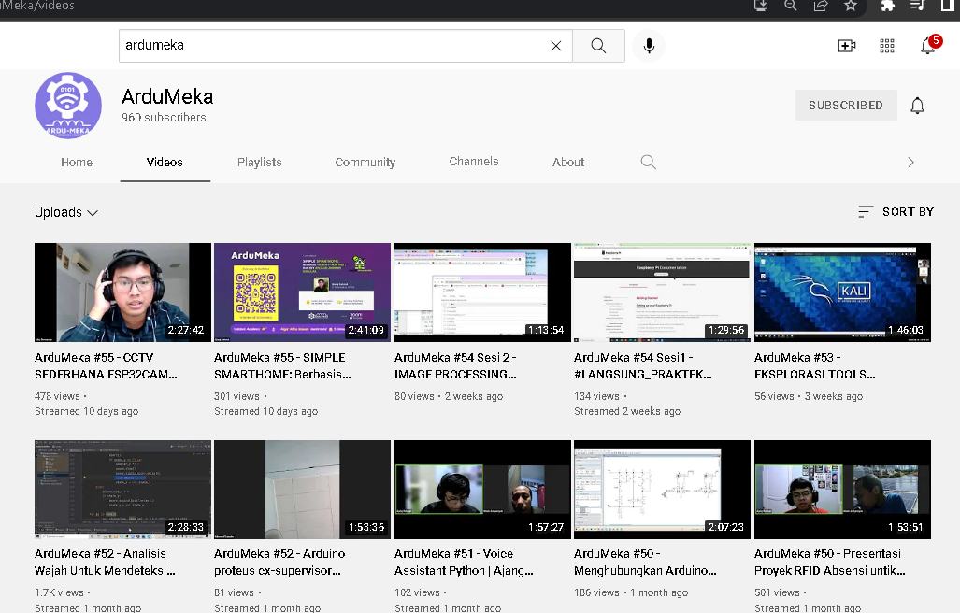
SUPPORT US

Slide 27
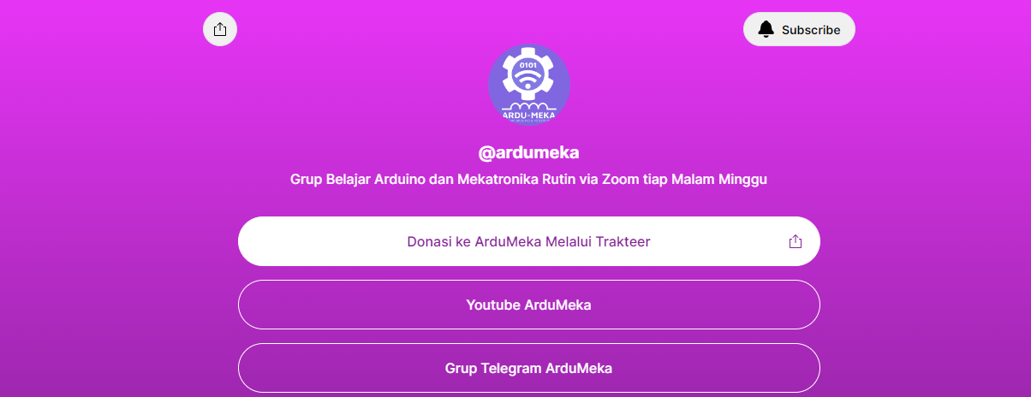

Slide 28
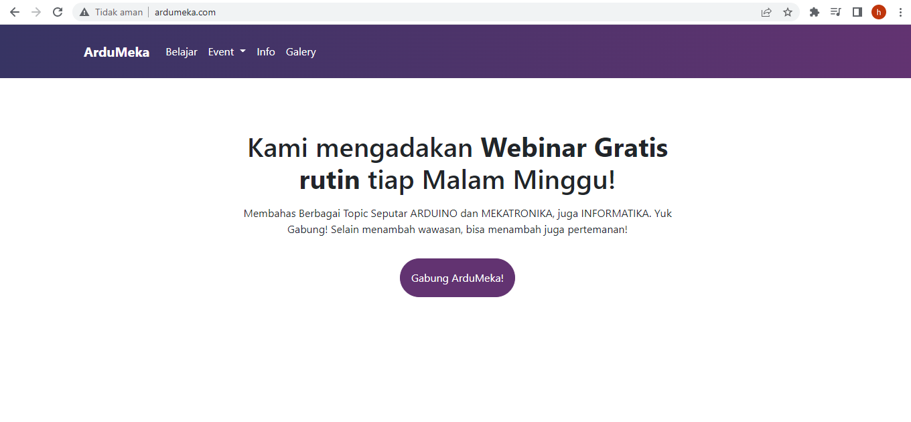

Slide 29
SEKIAN DAN TERIMAKASIH ☺

